Slide 1
UA ASCEND Life Sciences
Using the Ames test to measure the viability and mutagenicity of spacefaring Salmonella enterica and establish the efficacy of a flight platform
Duffy Elmer & Shobitha Jillella

Slide 2
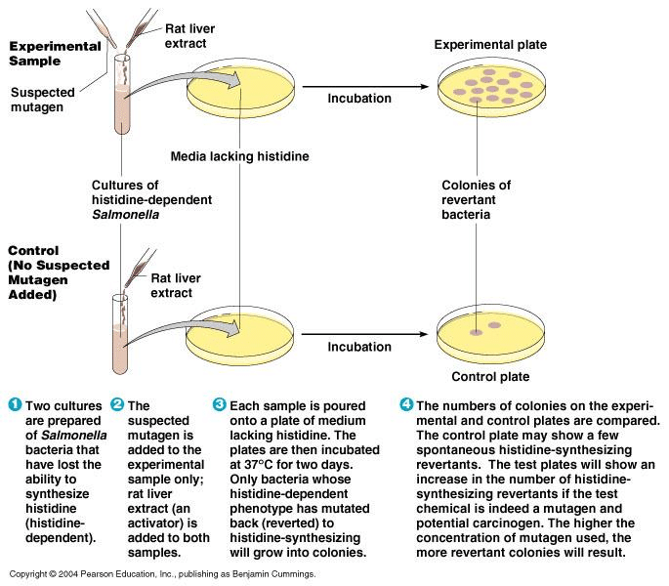
Experiment Objectives
Measuring effects of ionizing radiation on Salmonella enterica via the Ames mutagenicity assay.
Providing proof of concept and conducting a test flight in preparation for the AZSGC RockSat-C mission launching in June 2018.

Slide 3
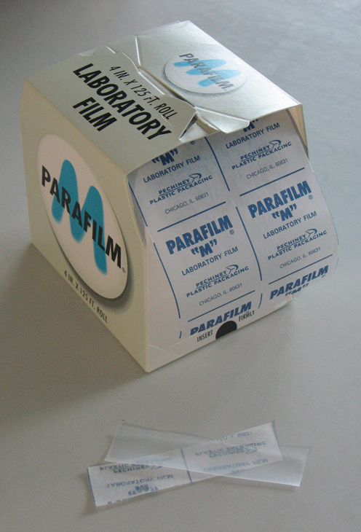
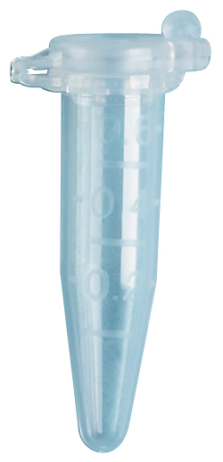
Sample Containment
Locking-Cap Microcentrifuge Tubes
  Rated to 10,000g
Parafilm

Slide 4
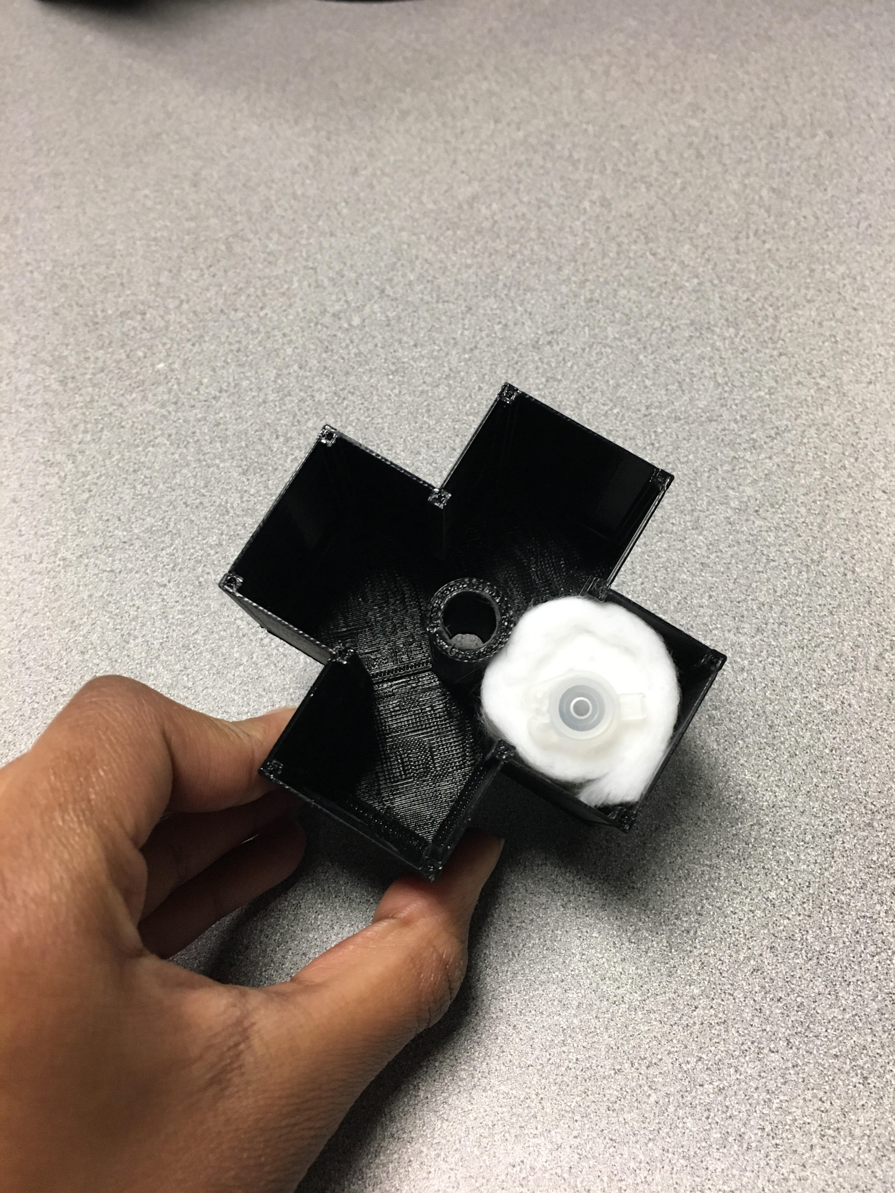
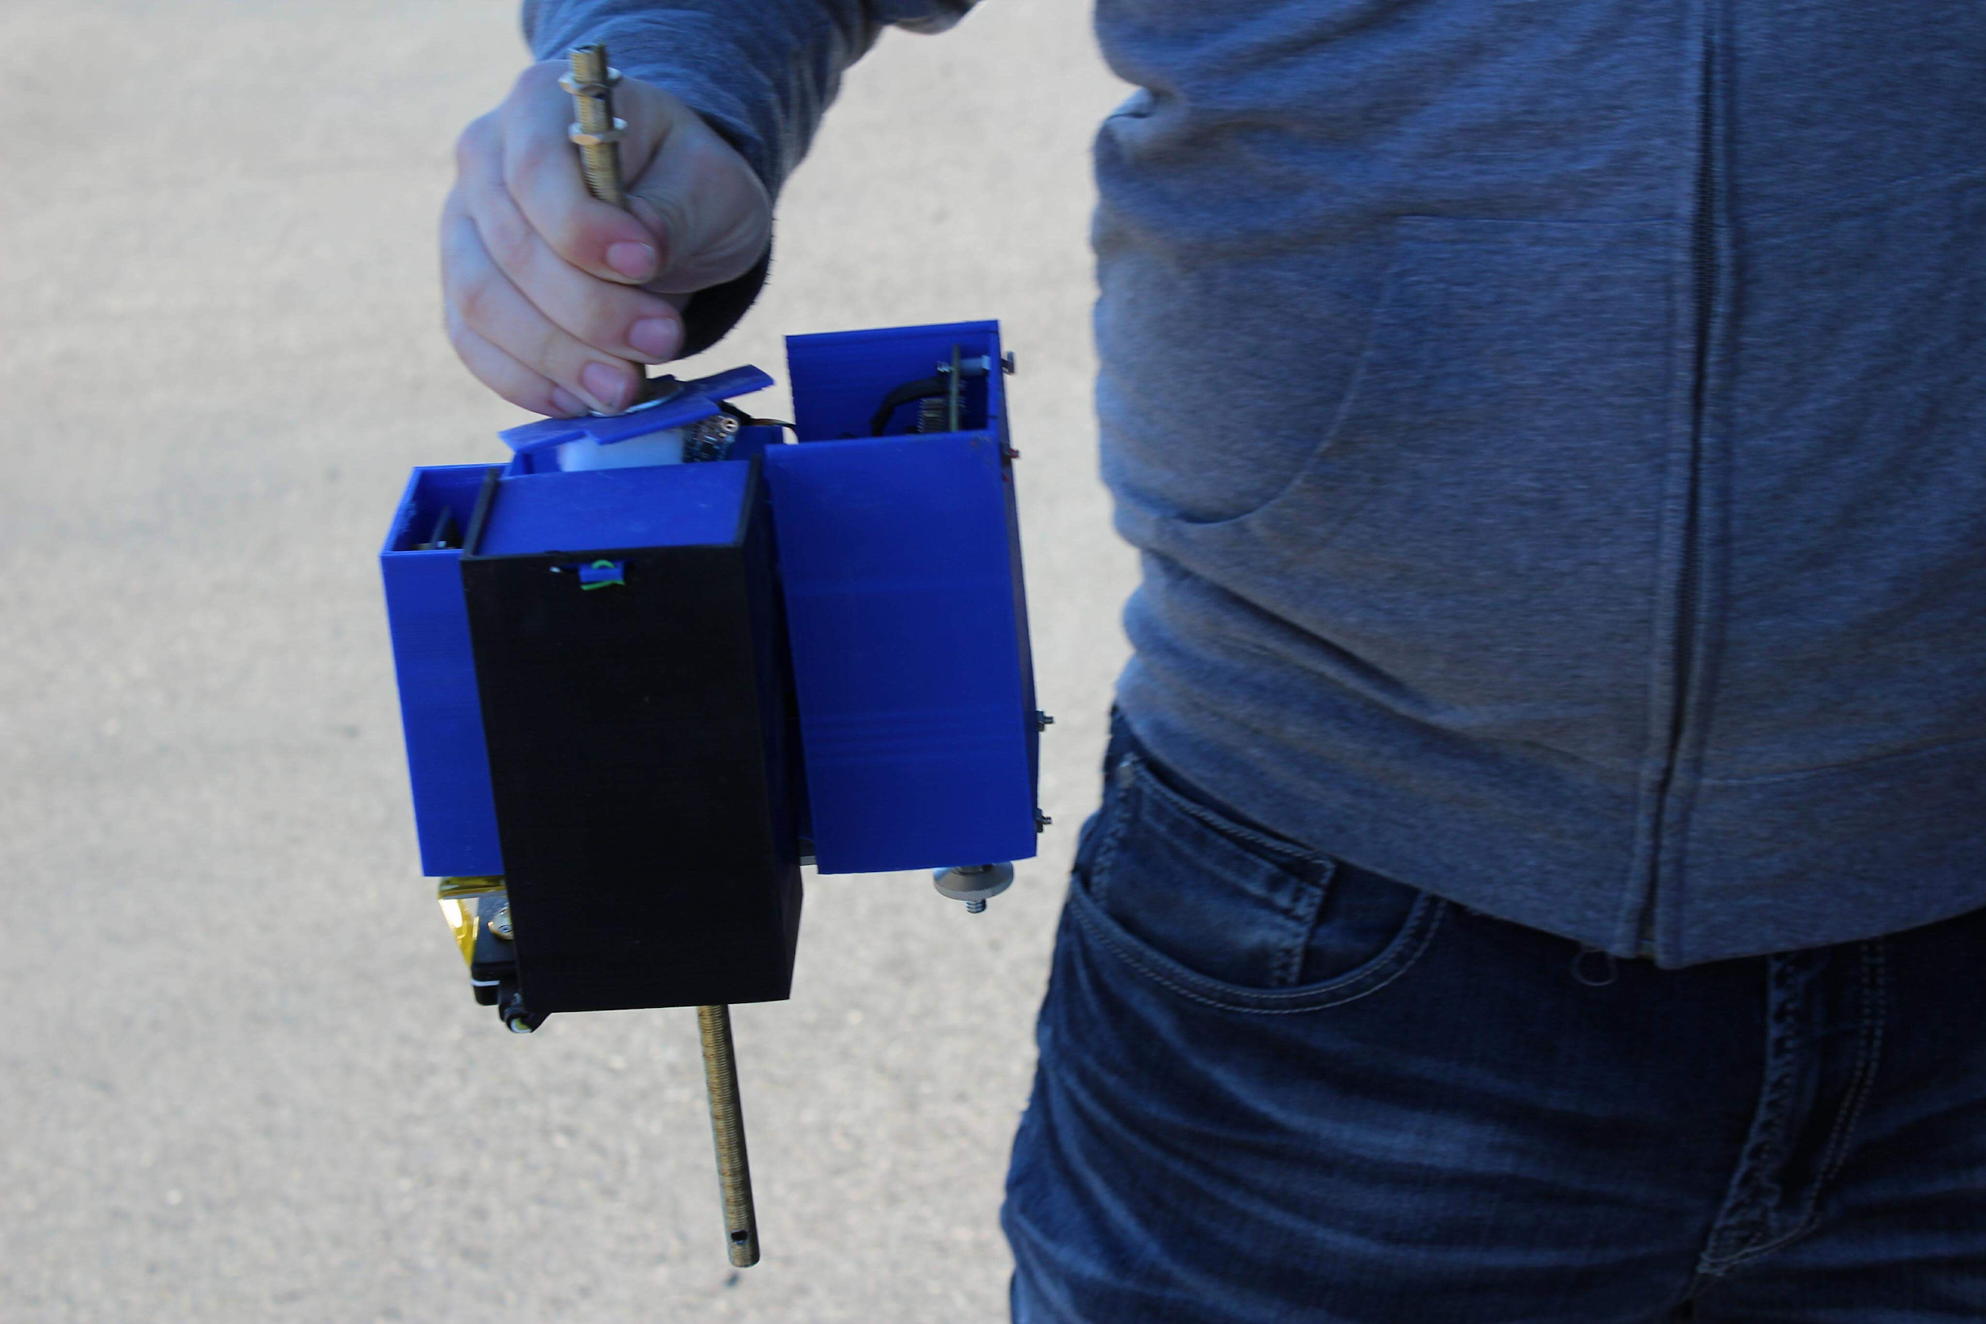
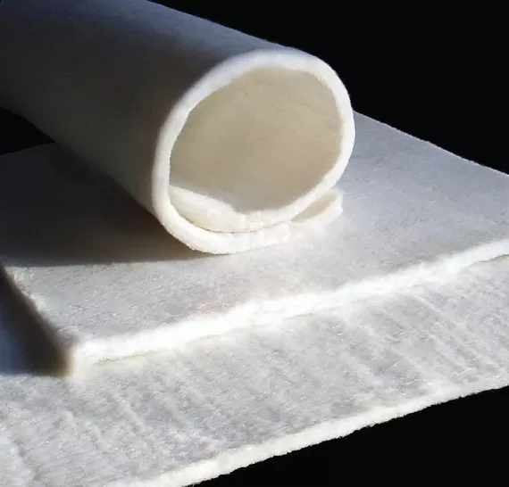
Sample Containment
Absorbent Aerogel Insulation
Isolated 3D-printed (PLA) Container

Slide 5
Methodology
Experimental Flight Samples
Ground Control
Identical Incubation
Dilution series and colony counting

Slide 6
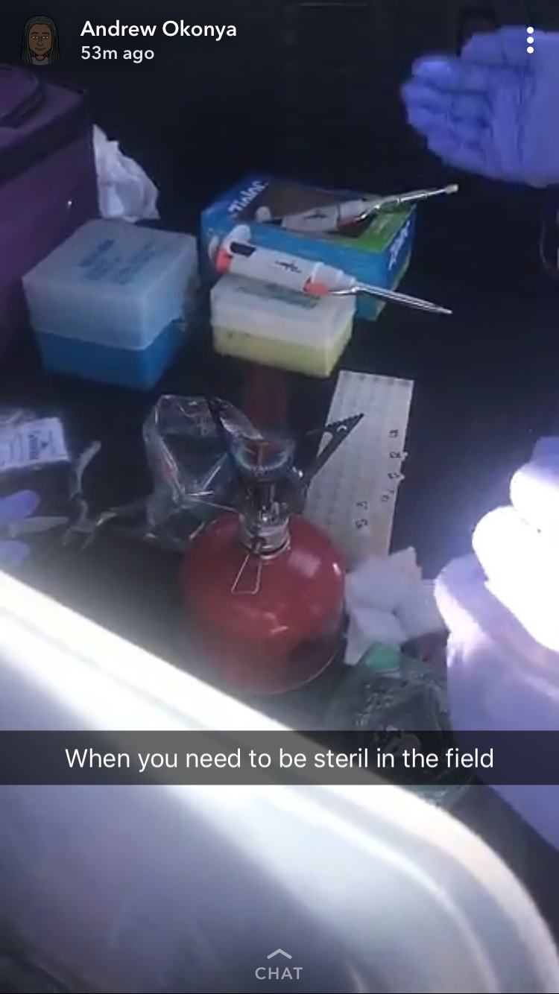
Methodology
Incubation
(Pre- and Post-flight)
Maintaining sterile technique in the field

Slide 7
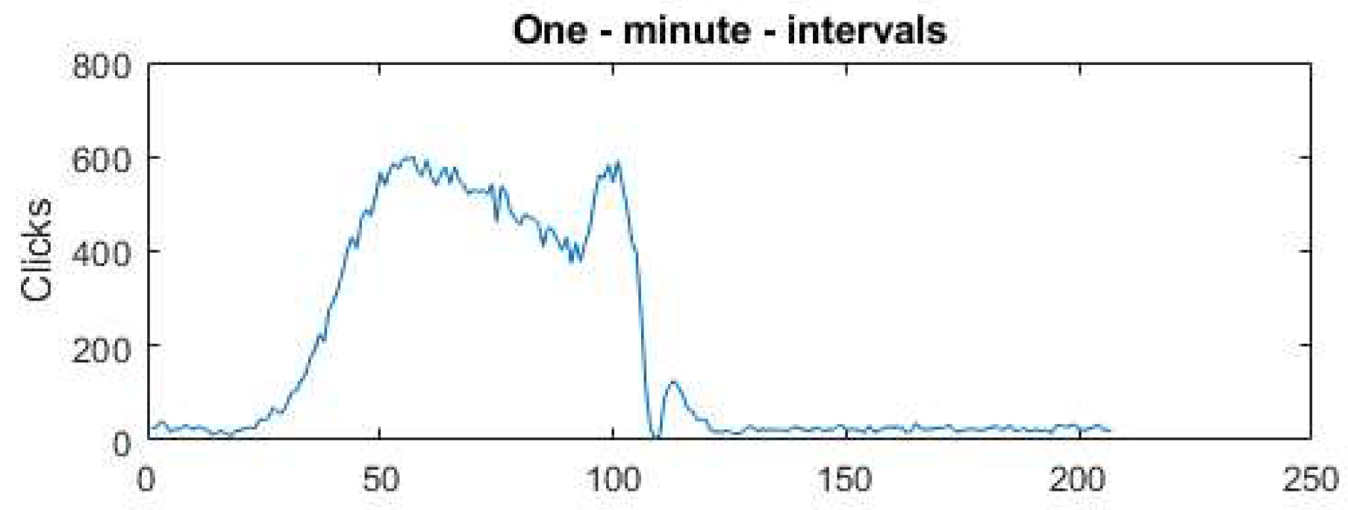
Results and Data
Time
(Minutes)
Measurement of radiation levels over time shows the samples experienced beta and gamma radiation during the flight

Slide 8
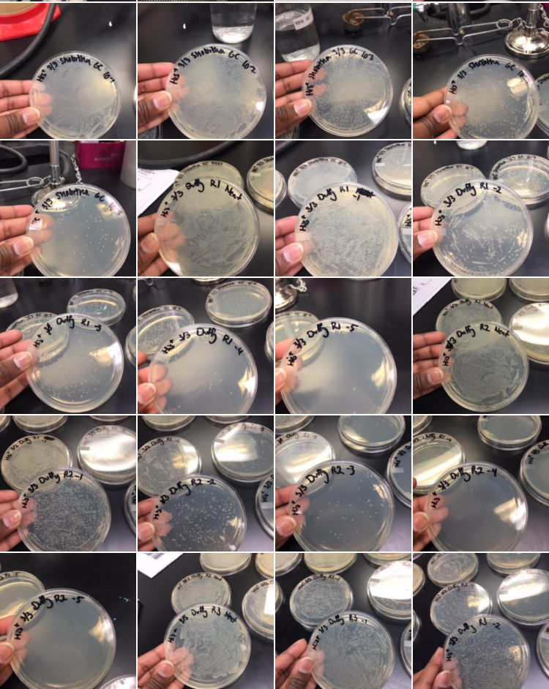
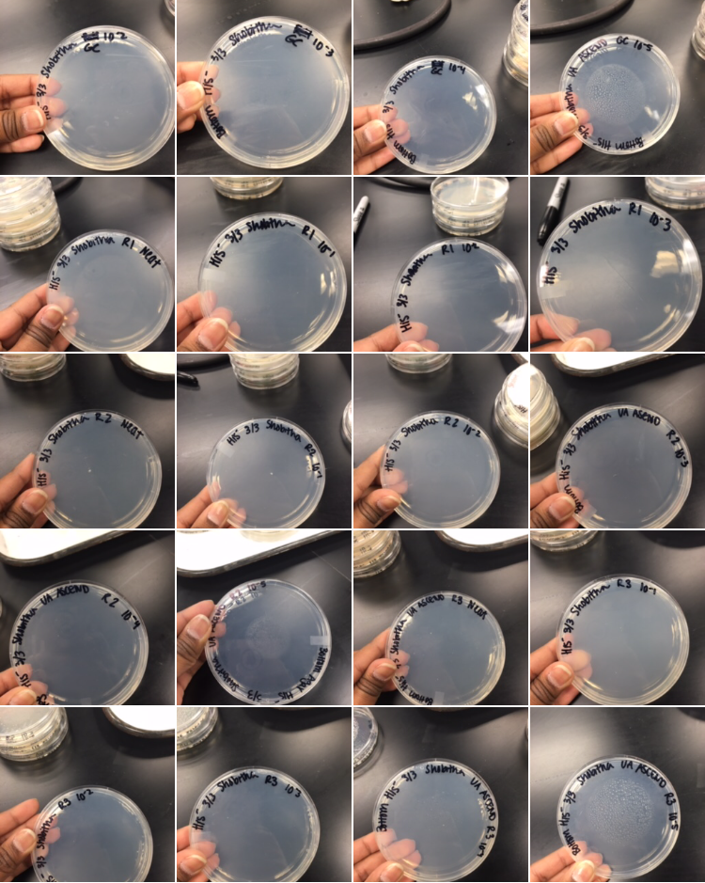
Results and Data
Colony counts on nutrient-rich media show proof of in-flight sample viability

Slide 9
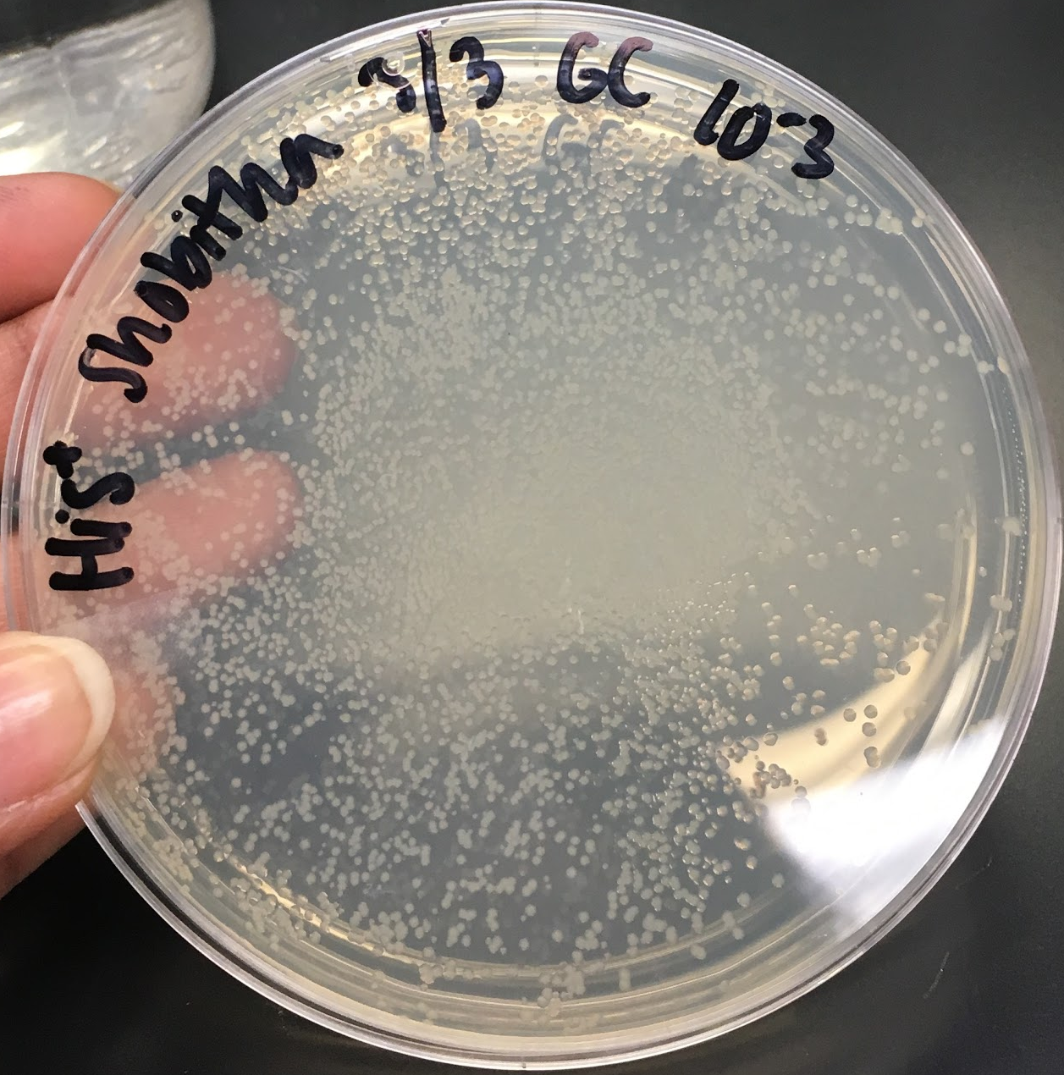
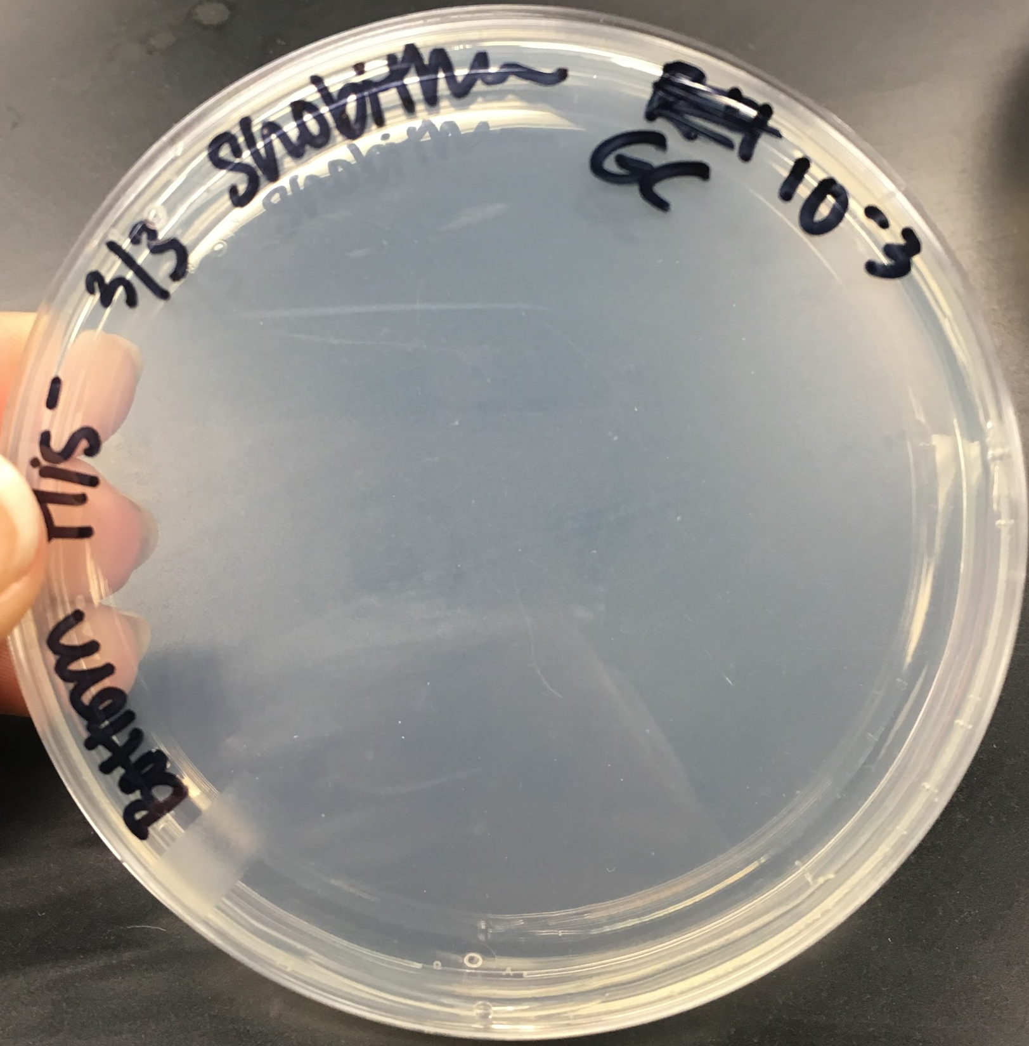
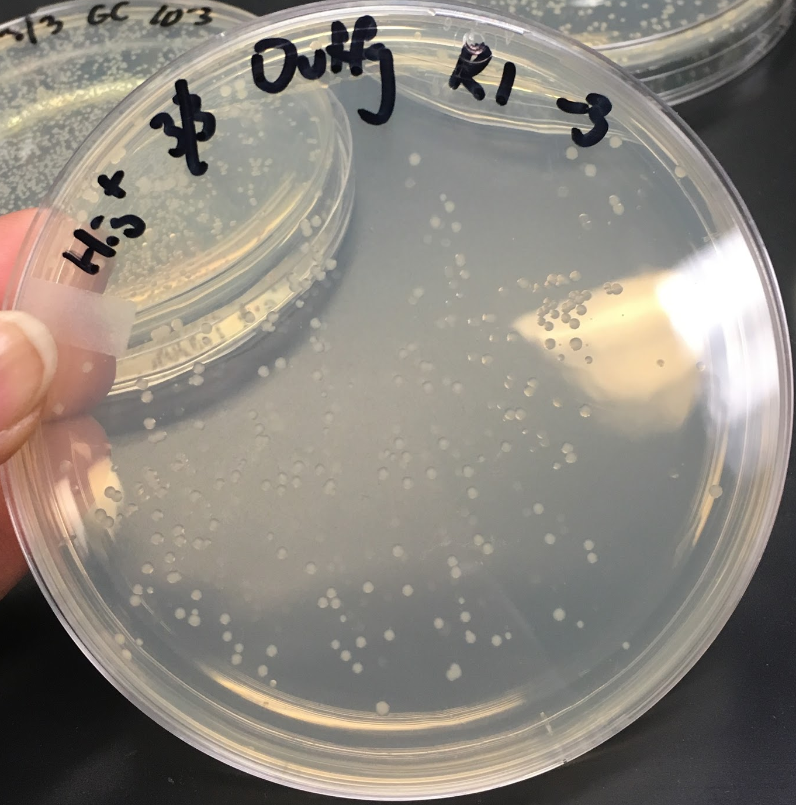
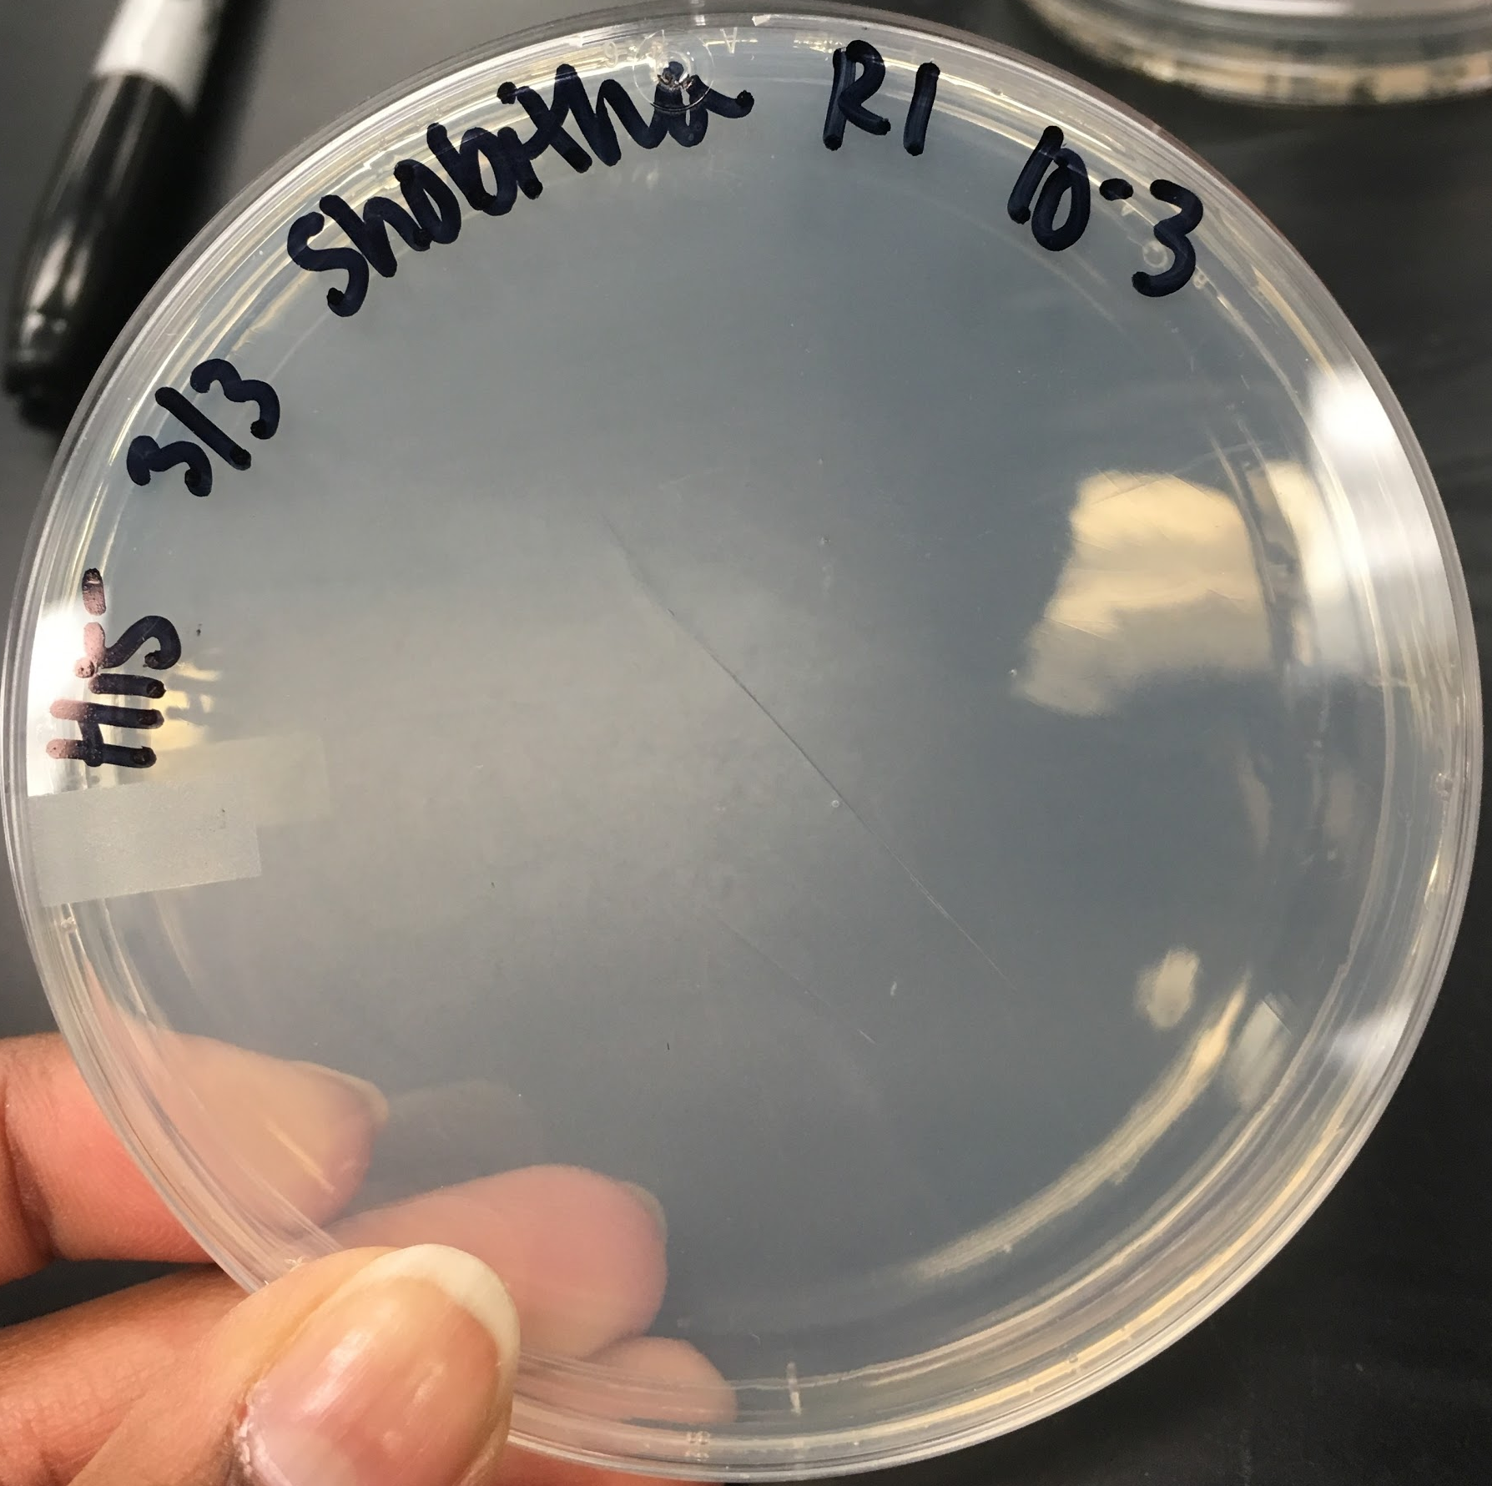
Results and Data
Mutated colonies observed, but not statistically significant

Slide 10
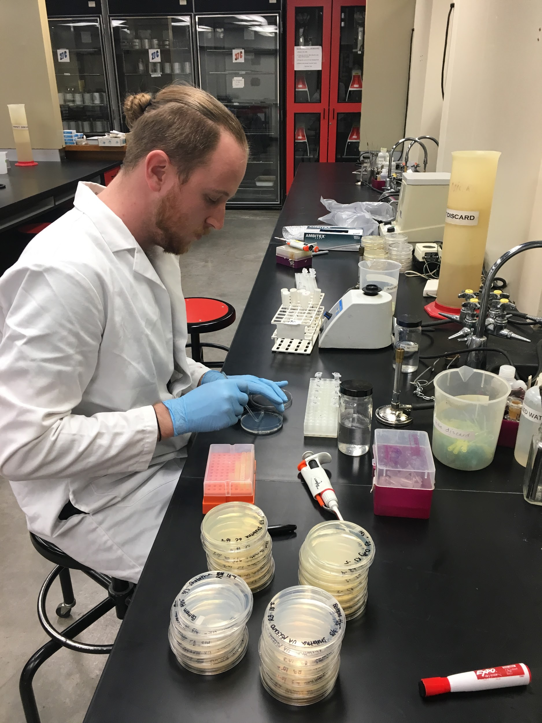
Conclusions
Flight negatively affects cell viability
  10-fold decrease in survival
Our apparatus allows for live cell recovery

Slide 11
Future Directions
Testing with on-flight radiation shielding
  Radiation-specific control
Sounding rocket flight to Thermosphere
  Gel Fixation
  Increased Container Durability
Other Cell types
  TA98 Salmonella
  Human Immune Cells

Slide 12
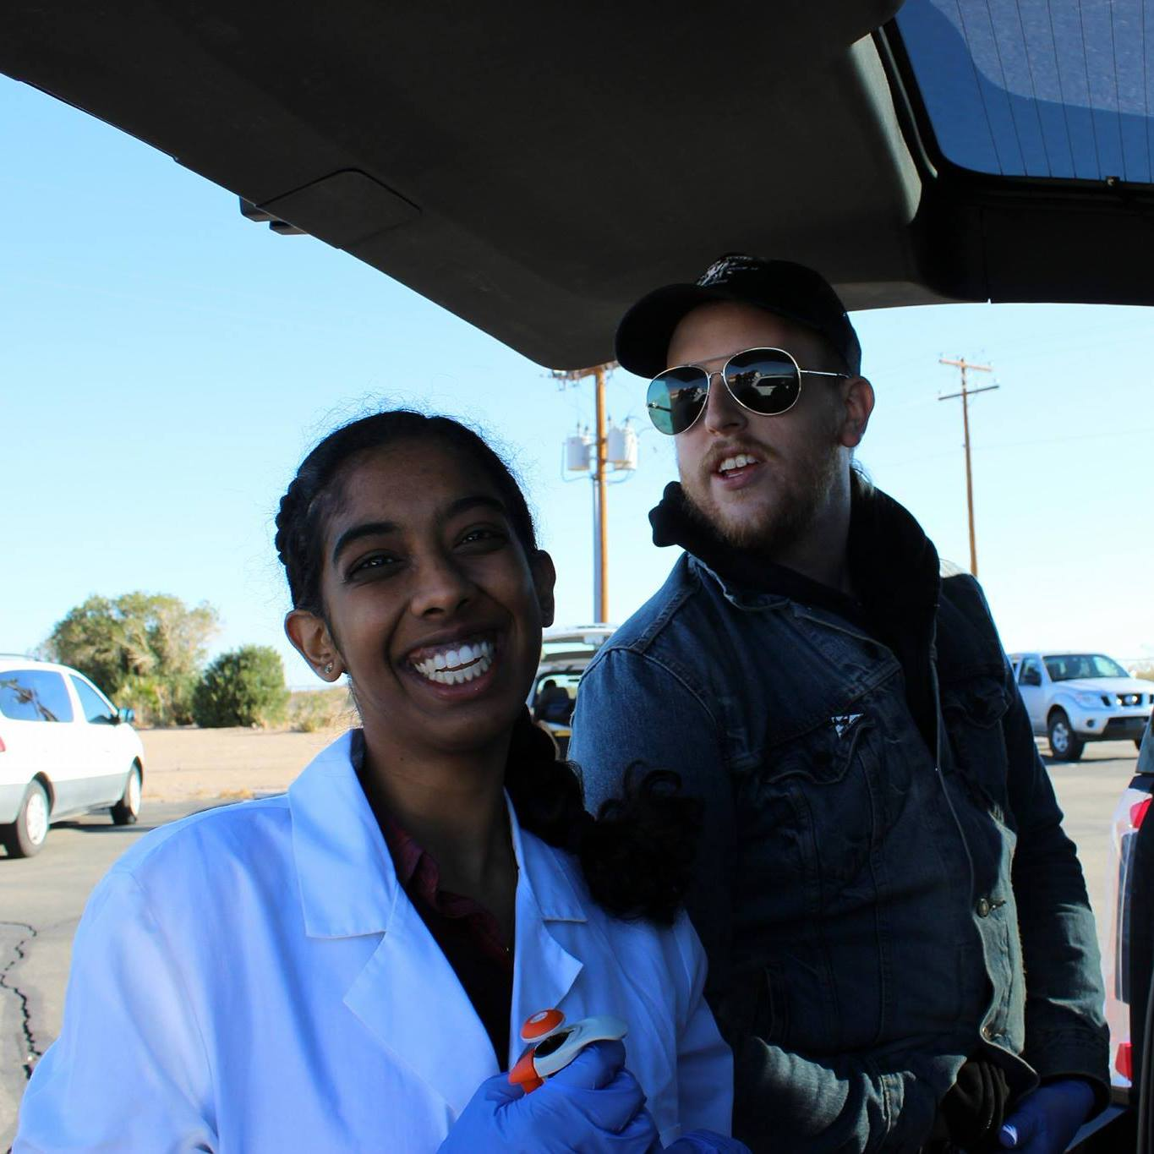
Acknowledgements
Dr. John S. Wilbur, UA Microbiology Teaching Lab Prep Room, Susan Brew, AZSG, ANSR, UA SEDS, ASU

